Slide 1
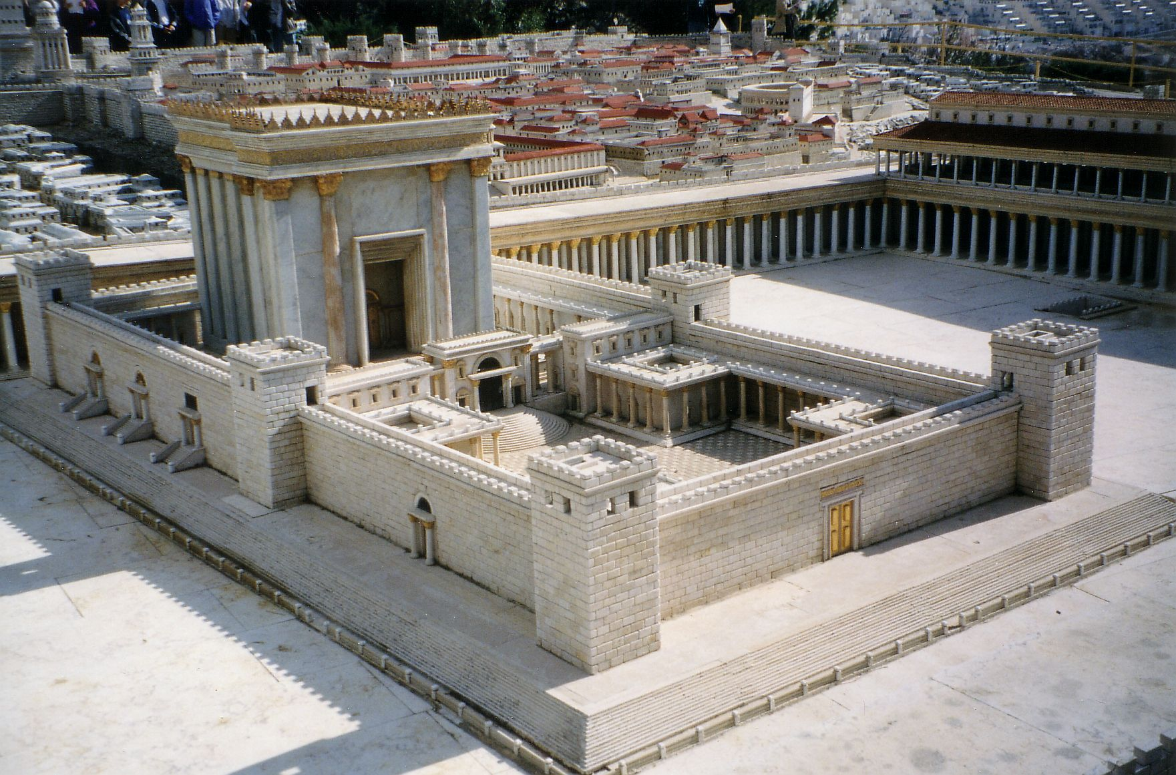
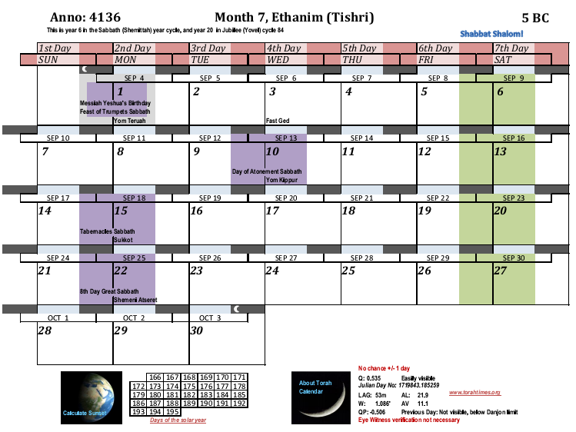
PART II
I start in 5 BC for the Null hypothesis, which will show that the priestly rotations do not support the 3 BC dating for Messiah’s birth. The divisions start on the Sabbath before Tishri 1 with Jehoiarib, as we discovered from R. Halaphta’s statement.
Order of the
divisions,
1. Jehoiarib
2. Jedaiah
3. Harim
4. Seorim
5. Malchijah
6. Mijamin
7. Hakkoz
8. Abijah
9. Jeshua
10. Shecaniah
11. Eliashib
12. Jakim
13. Huppah
14. Jeshebeab
15. Bilgah
16. Immer
17. Hezir
18. Happizzez
19. Pethahiah
20. Jehezkel
21. Jachin
22. Gamul
23. Delaiah
24. Maaziah
4135
1. Jehoiarib
2. Jedaiah
3. Harim
4. Seorim
5. Malchijah

Slide 2
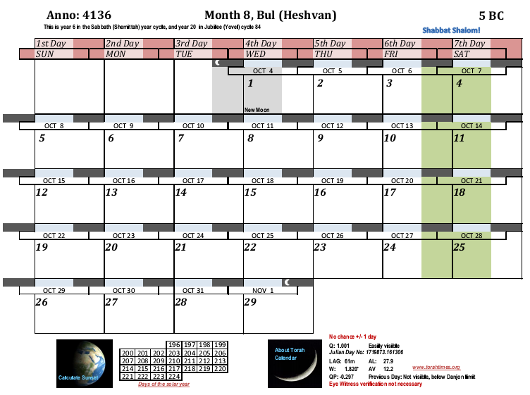
Order of the
divisions,
1. Jehoiarib
2. Jedaiah
3. Harim
4. Seorim
5. Malchijah
6. Mijamin
7. Hakkoz
8. Abijah
9. Jeshua
10. Shecaniah
11. Eliashib
12. Jakim
13. Huppah
14. Jeshebeab
15. Bilgah
16. Immer
17. Hezir
18. Happizzez
19. Pethahiah
20. Jehezkel
21. Jachin
22. Gamul
23. Delaiah
24. Maaziah
4135
5. Malchijah
6. Mijamin
7. Hakkoz
8. Abijah
9. Jeshua

Slide 3
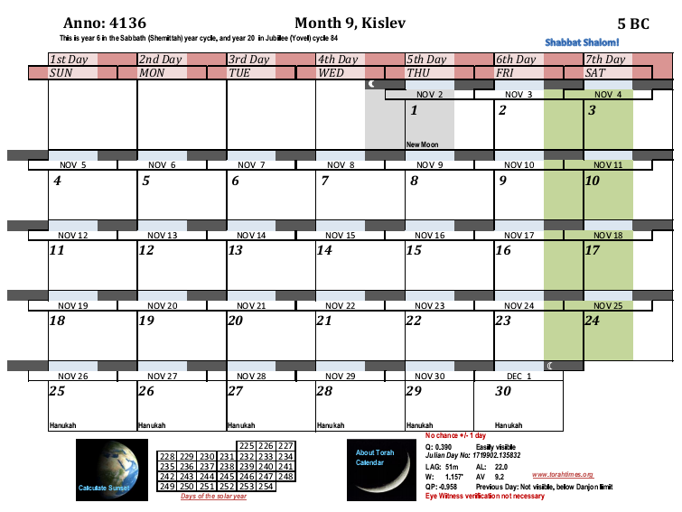
Order of the
divisions,
1. Jehoiarib
2. Jedaiah
3. Harim
4. Seorim
5. Malchijah
6. Mijamin
7. Hakkoz
8. Abijah
9. Jeshua
10. Shecaniah
11. Eliashib
12. Jakim
13. Huppah
14. Jeshebeab
15. Bilgah
16. Immer
17. Hezir
18. Happizzez
19. Pethahiah
20. Jehezkel
21. Jachin
22. Gamul
23. Delaiah
24. Maaziah
4135
9. Jeshua
10. Shecaniah
11. Eliashib
12. Jakim
13. Huppah

Slide 4
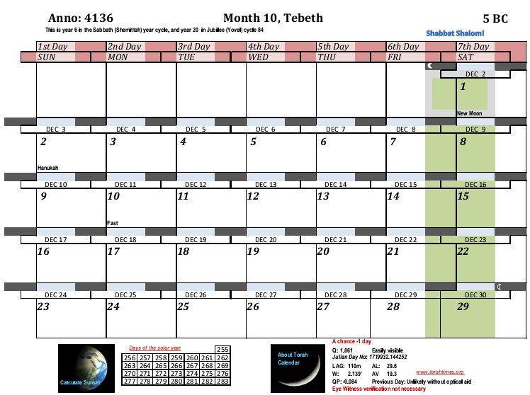
Order of the
divisions,
1. Jehoiarib
2. Jedaiah
3. Harim
4. Seorim
5. Malchijah
6. Mijamin
7. Hakkoz
8. Abijah
9. Jeshua
10. Shecaniah
11. Eliashib
12. Jakim
13. Huppah
14. Jeshebeab
15. Bilgah
16. Immer
17. Hezir
18. Happizzez
19. Pethahiah
20. Jehezkel
21. Jachin
22. Gamul
23. Delaiah
24. Maaziah
4135
13. Huppah
14. Jeshebeab
15. Bilgah
16. Immer
17. Hezir

Slide 5
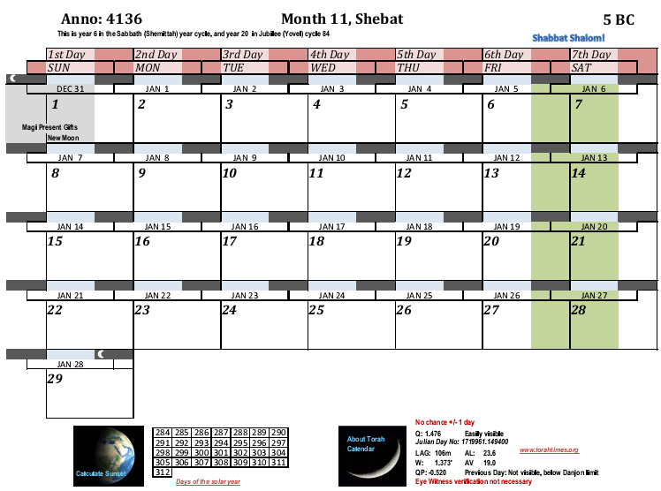
Order of the
divisions,
1. Jehoiarib
2. Jedaiah
3. Harim
4. Seorim
5. Malchijah
6. Mijamin
7. Hakkoz
8. Abijah
9. Jeshua
10. Shecaniah
11. Eliashib
12. Jakim
13. Huppah
14. Jeshebeab
15. Bilgah
16. Immer
17. Hezir
18. Happizzez
19. Pethahiah
20. Jehezkel
21. Jachin
22. Gamul
23. Delaiah
24. Maaziah
4135
18. Happizzez
19. Pethahiah
20. Jehezkel
21. Jachin
22. Gamul

Slide 6
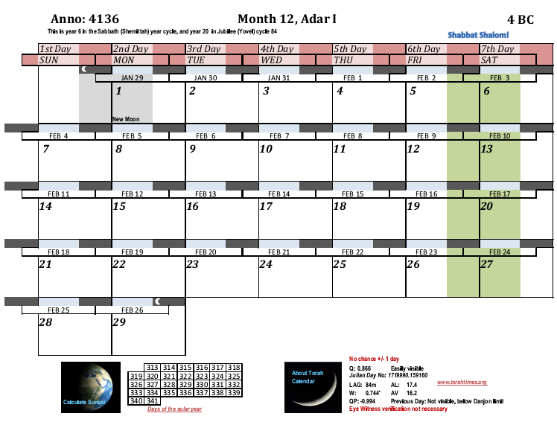
Order of the
divisions,
1. Jehoiarib
2. Jedaiah
3. Harim
4. Seorim
5. Malchijah
6. Mijamin
7. Hakkoz
8. Abijah
9. Jeshua
10. Shecaniah
11. Eliashib
12. Jakim
13. Huppah
14. Jeshebeab
15. Bilgah
16. Immer
17. Hezir
18. Happizzez
19. Pethahiah
20. Jehezkel
21. Jachin
22. Gamul
23. Delaiah
24. Maaziah
4135
22. Gamul
23. Delaiah
24. Maaziah
1. Jehoiarib
2. Jedaiah

Slide 7
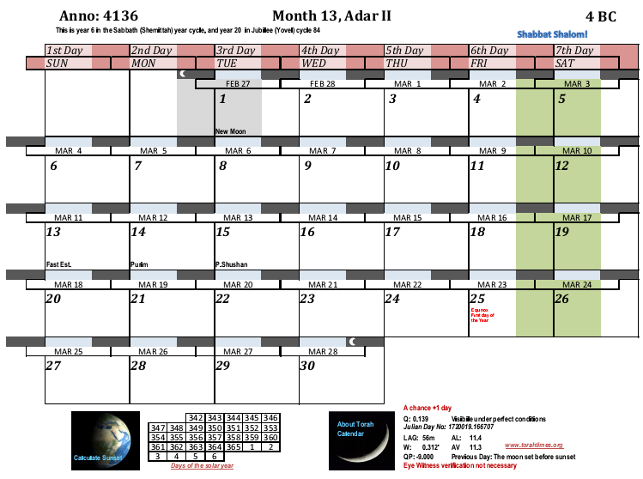
Order of the
divisions,
1. Jehoiarib
2. Jedaiah
3. Harim
4. Seorim
5. Malchijah
6. Mijamin
7. Hakkoz
8. Abijah
9. Jeshua
10. Shecaniah
11. Eliashib
12. Jakim
13. Huppah
14. Jeshebeab
15. Bilgah
16. Immer
17. Hezir
18. Happizzez
19. Pethahiah
20. Jehezkel
21. Jachin
22. Gamul
23. Delaiah
24. Maaziah
4135
2. Jedaiah
3. Harim
4. Seorim
5. Malchijah
6. Mijamin

Slide 8
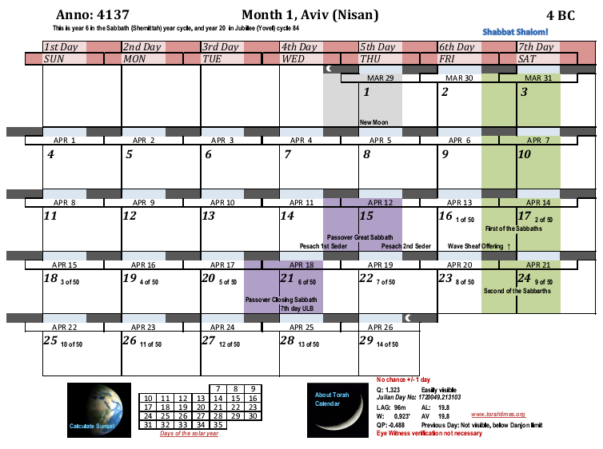
Now Zechariah was of the division of Abijah. If the annunciation was in 4 BC, then his service would end on Nisan 17.
Order of the
divisions,
1. Jehoiarib
2. Jedaiah
3. Harim
4. Seorim
5. Malchijah
6. Mijamin
7. Hakkoz
8. Abijah
9. Jeshua
10. Shecaniah
11. Eliashib
12. Jakim
13. Huppah
14. Jeshebeab
15. Bilgah
16. Immer
17. Hezir
18. Happizzez
19. Pethahiah
20. Jehezkel
21. Jachin
22. Gamul
23. Delaiah
24. Maaziah
The maximum time needed for Elizabeth’s body to prepare for conception is 14 days, assuming that the Almighty performed the miracle to restart her fertility renewal as soon as Zechariah went off duty. A shorter time will be worse for the NULL hypothesis here. A longer time is unreasonable, since we expect Yahweh fulfill his word promptly. The reason for this is that enough chronological data is included in the Scripture to figure this out. The Scripture is thus showing that by including the information that it should be figured out with assumptions that do not make the result impossible to figure out. Assuming an untimely fulfillment of the word would reduce the whole chronology to ambiguity. The arrow points to the NULL hypothesis conception date, which we will find in the next calendar chart.
4136
6. Mijamin
7. Hakkoz
8. Abijah

Slide 9
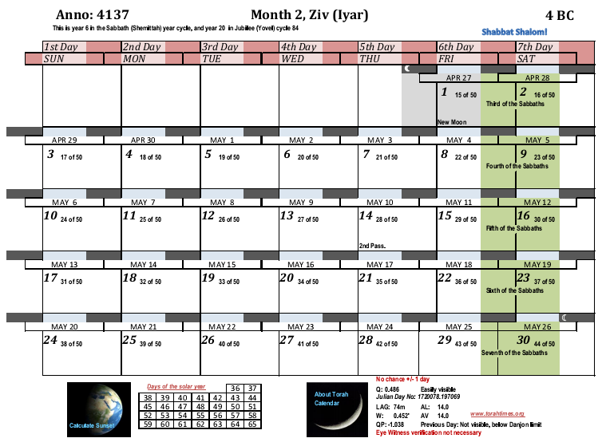
NULL hypothesis conception date for John the Baptist
4136
Now we count off 6 months to reach the annunciation to Miriam. Strictly speaking, the month counting begins on the 2nd day of each month here since the conception is on the second day of the month.
1

Slide 10
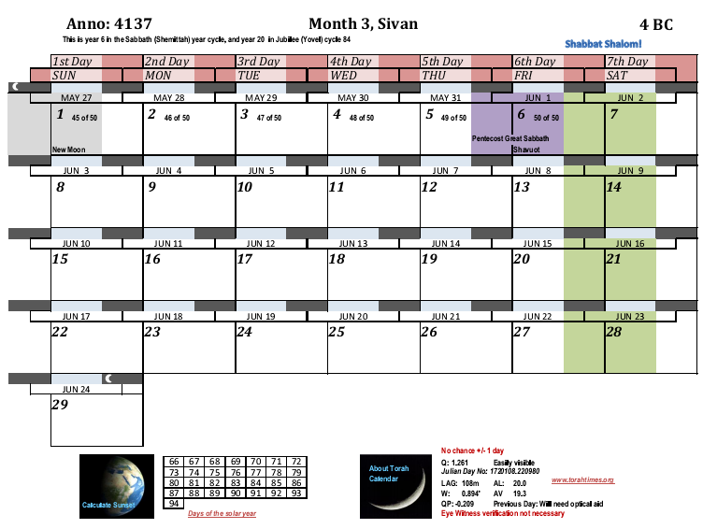
4136
2

Slide 11
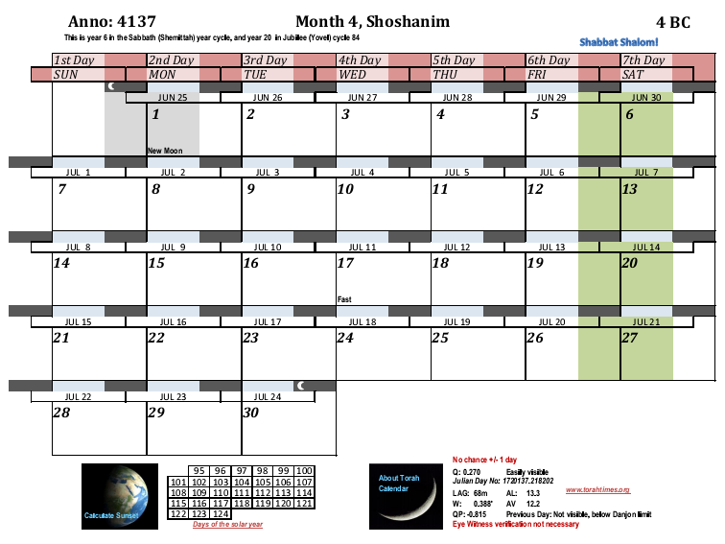
4136
3

Slide 12
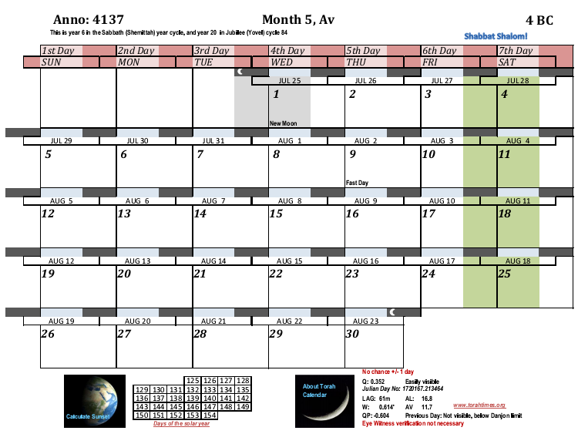
4136
4

Slide 13
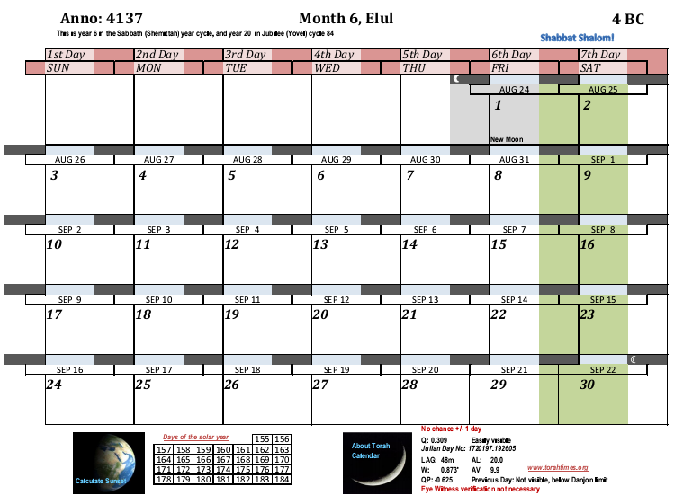
4136
5

Slide 14
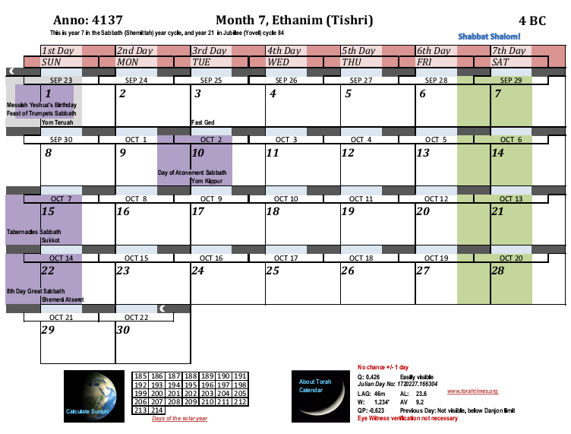
4136
The annunciation to Miriam was in the 6th month of Elizabeth. What is the reasonable amount of time here? The NULL hypothesis is going to come up too short on the time. What we need for the correct hypothesis (2 BC) is the maximum amount of time reasonable. So we will use the maximum reasonable time here. I am treating both theories exactly the same in this astronomical “thought” experiment.
6
Therefore, we will peg the NULL hypothesis annunciation here on the new moon day.

Slide 15
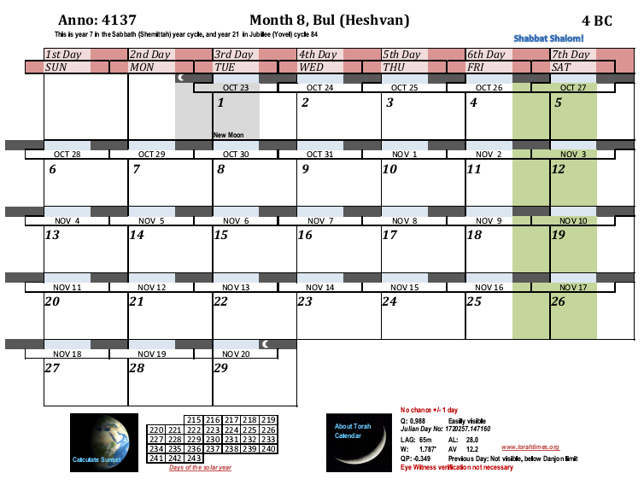
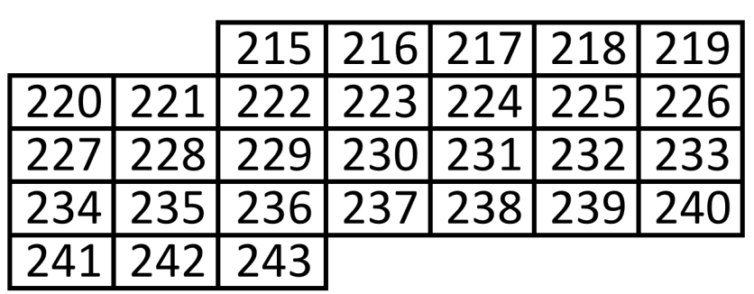
Next, we make the same assumption as with the TRUE hypothesis (Both hypothesis need the maximum amount of time). We say that Miryam had just begun the third week of her cycle at the annunciation, i.e. had just missed the time of fertility. That is she was on day 16 or so of the 28 day cycle. This means that conception comes in three weeks, on day 14 of the next cycle.
Now we have the NULL hypothesis conception date for Yeshua, the 28th day of the 8th month.
NULL Annunciation Date
4136
The 7th month would begin on the 2nd day of the month here.

Slide 16
We next look to see what day of the year the conception was on: 242.
The time from conception to birth averages 266 days. Often people will say 10 lunar months or 9 Roman months. The 10 month figure uses inclusive counting, and the 9 month figure is from the date of the last cycle on Roman months. Sometimes it is stated as 280 days. When the conception date is known however, the number of days is 266. This is a well researched and established figure. The difference between the conception date and the start of the last cycle is 14 days, i.e. 280 – 14 = 266. The reason for this is that women usually know when their cycle ends better than when they conceived.
Therefore, by adding 266 days to the day of the year (242) and then subtracting the solar year, we find the year target date for the birth in the next year. (This calculation is independent of this calendar system I am using. We are just going forward 266 days.)
266 + 242 – 365 = 143. The NULL hypothesis birth is expected on day 143 of the year (counting from the spring equinox). Let us now fast forward to the month containing this date.
4136

Slide 17
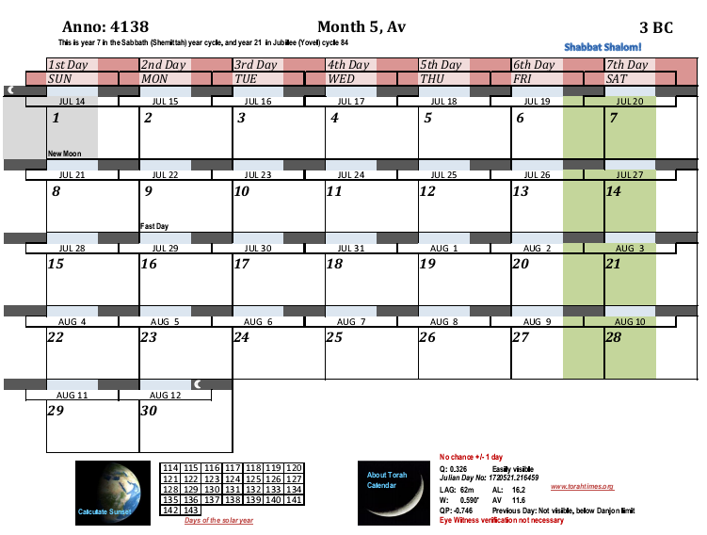
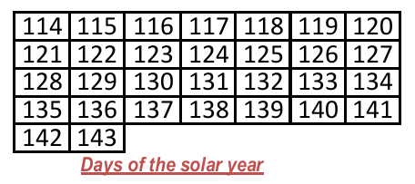
Here we are, at day 143 of the next year.
4137
How many days overdue does the baby have to be to make the NULL hypothesis true to a Tishri 1 date?

Slide 18
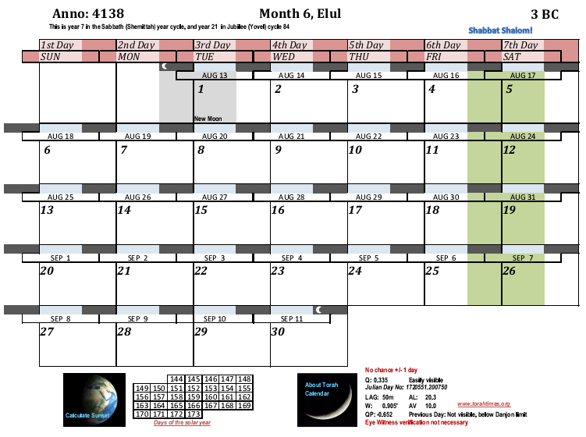
4137
1
2
3
4
5
6
7
8
9
10
11
12
13
14
15
16
17
18
19
20
21
22
23
24
25
26
27
28
29
30

Slide 19
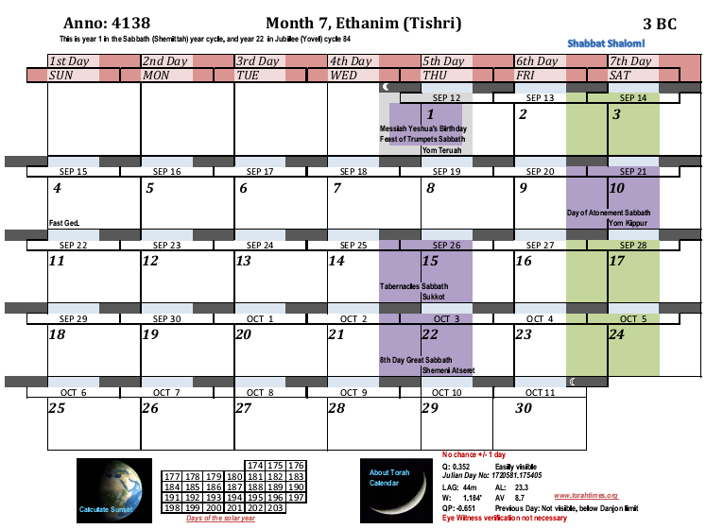
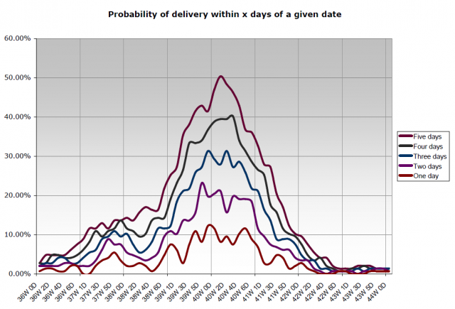
Do we really expect that the Almighty will give us the sign in heaven, the data on the course of Abijah, the sixth month datum, and other clues only to throw it all away with a statistically improbable birth date?
4137
Someone did a survey and stats on pregnancy terms. To use the survey we need to compute weeks using the date of the last cycle, i.e. 280 days + 30 = 310 days.
Divided by 7 that makes 44.28 weeks. We can see that 44.28 weeks is off the end of this chart:

Slide 20
Ok. Let us now test the TRUE hypothesis
Model of the Second Temple after Herod’s reconstruction.

Slide 22
We start counting the divisions in Tishri 4 BC for the TRUE hypothesis
Order of the
divisions,
1. Jehoiarib
2. Jedaiah
3. Harim
4. Seorim
5. Malchijah
6. Mijamin
7. Hakkoz
8. Abijah
9. Jeshua
10. Shecaniah
11. Eliashib
12. Jakim
13. Huppah
14. Jeshebeab
15. Bilgah
16. Immer
17. Hezir
18. Happizzez
19. Pethahiah
20. Jehezkel
21. Jachin
22. Gamul
23. Delaiah
24. Maaziah
4136
1. Jehoiarib
2. Jedaiah
3. Harim
4. Seorim
5. Malchijah

Slide 23
Order of the
divisions,
1. Jehoiarib
2. Jedaiah
3. Harim
4. Seorim
5. Malchijah
6. Mijamin
7. Hakkoz
8. Abijah
9. Jeshua
10. Shecaniah
11. Eliashib
12. Jakim
13. Huppah
14. Jeshebeab
15. Bilgah
16. Immer
17. Hezir
18. Happizzez
19. Pethahiah
20. Jehezkel
21. Jachin
22. Gamul
23. Delaiah
24. Maaziah
4136
5. Malchijah
6. Mijamin
7. Hakkoz
8. Abijah
9. Jeshua

Slide 24
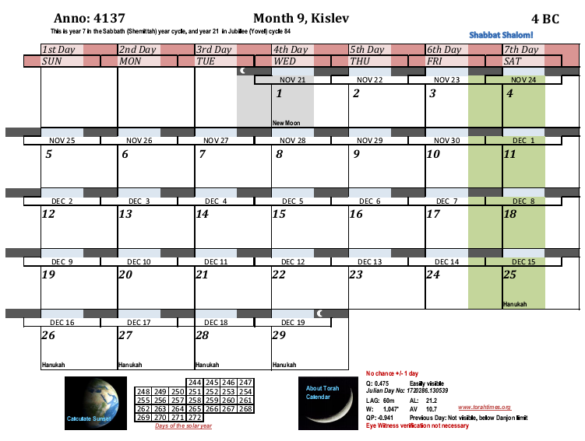
Order of the
divisions,
1. Jehoiarib
2. Jedaiah
3. Harim
4. Seorim
5. Malchijah
6. Mijamin
7. Hakkoz
8. Abijah
9. Jeshua
10. Shecaniah
11. Eliashib
12. Jakim
13. Huppah
14. Jeshebeab
15. Bilgah
16. Immer
17. Hezir
18. Happizzez
19. Pethahiah
20. Jehezkel
21. Jachin
22. Gamul
23. Delaiah
24. Maaziah
4136
9. Jeshua
10. Shecaniah
11. Eliashib
12. Jakim
13. Huppah

Slide 25
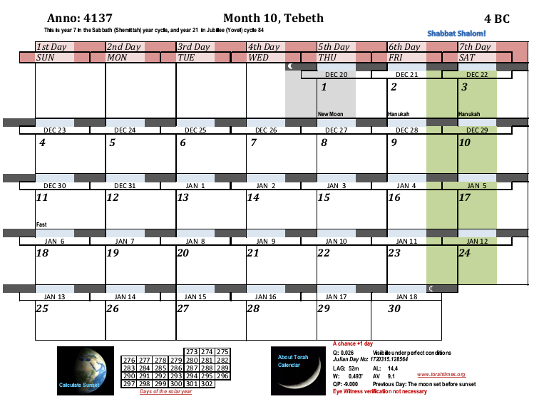
Order of the
divisions,
1. Jehoiarib
2. Jedaiah
3. Harim
4. Seorim
5. Malchijah
6. Mijamin
7. Hakkoz
8. Abijah
9. Jeshua
10. Shecaniah
11. Eliashib
12. Jakim
13. Huppah
14. Jeshebeab
15. Bilgah
16. Immer
17. Hezir
18. Happizzez
19. Pethahiah
20. Jehezkel
21. Jachin
22. Gamul
23. Delaiah
24. Maaziah
4136
13. Huppah
14. Jeshebeab
15. Bilgah
16. Immer
17. Hezir

Slide 26
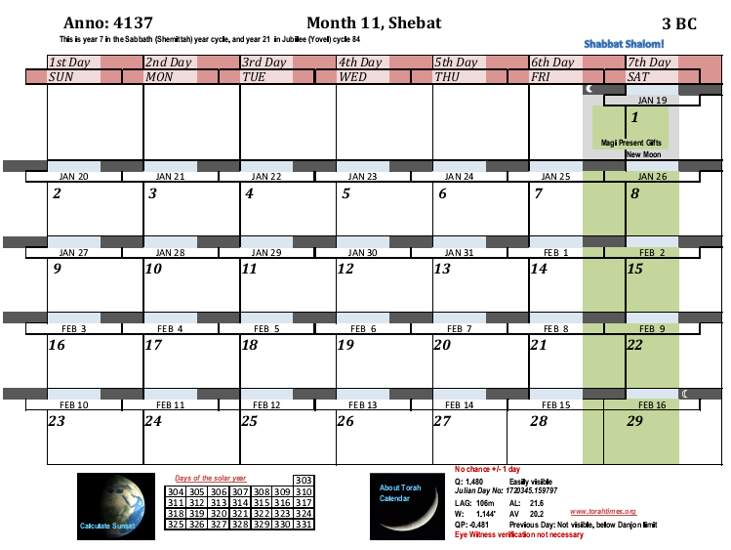
Order of the
divisions,
1. Jehoiarib
2. Jedaiah
3. Harim
4. Seorim
5. Malchijah
6. Mijamin
7. Hakkoz
8. Abijah
9. Jeshua
10. Shecaniah
11. Eliashib
12. Jakim
13. Huppah
14. Jeshebeab
15. Bilgah
16. Immer
17. Hezir
18. Happizzez
19. Pethahiah
20. Jehezkel
21. Jachin
22. Gamul
23. Delaiah
24. Maaziah
4136
17. Hezir
18. Happizzez
19. Pethahiah
20. Jehezkel
21. Jachin

Slide 27
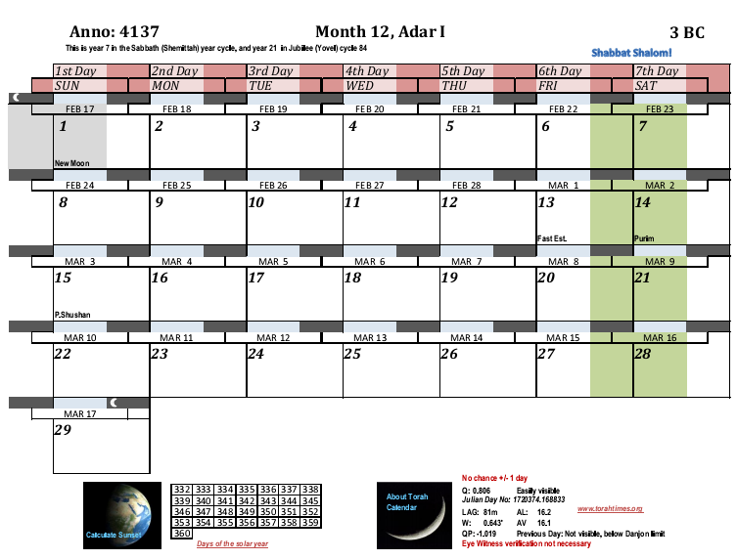
Order of the
divisions,
1. Jehoiarib
2. Jedaiah
3. Harim
4. Seorim
5. Malchijah
6. Mijamin
7. Hakkoz
8. Abijah
9. Jeshua
10. Shecaniah
11. Eliashib
12. Jakim
13. Huppah
14. Jeshebeab
15. Bilgah
16. Immer
17. Hezir
18. Happizzez
19. Pethahiah
20. Jehezkel
21. Jachin
22. Gamul
23. Delaiah
24. Maaziah
4136
22. Gamul
23. Delaiah
24. Maaziah
1. Jehoiarib
2. Jedaiah

Slide 28
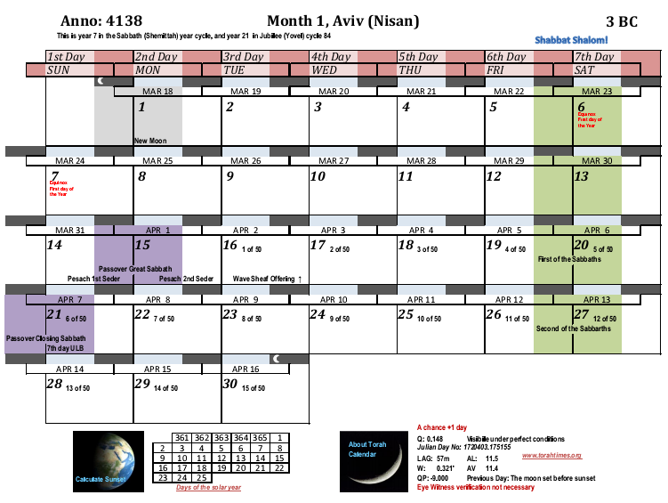
Order of the
divisions,
1. Jehoiarib
2. Jedaiah
3. Harim
4. Seorim
5. Malchijah
6. Mijamin
7. Hakkoz
8. Abijah
9. Jeshua
10. Shecaniah
11. Eliashib
12. Jakim
13. Huppah
14. Jeshebeab
15. Bilgah
16. Immer
17. Hezir
18. Happizzez
19. Pethahiah
20. Jehezkel
21. Jachin
22. Gamul
23. Delaiah
24. Maaziah
4137
2. Jedaiah
3. Harim
4. Seorim
5. Malchijah
6. Mijamin

Slide 29
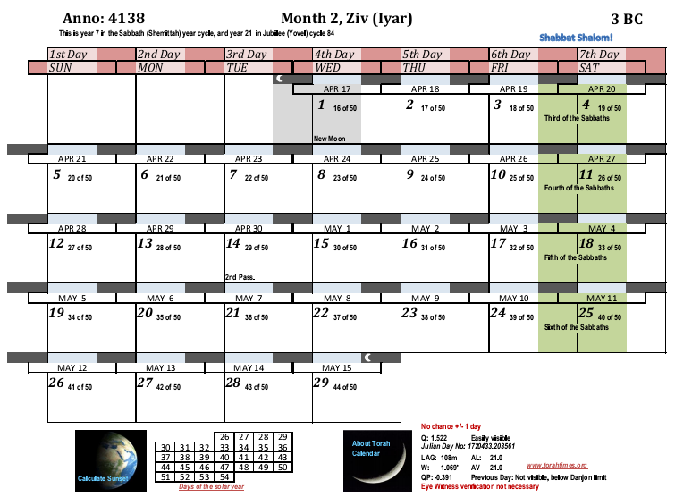
Now Zechariah was of the division of Abijah. With the annunciation in 3 BC, then his service ended on Ziv 18.
Order of the
divisions,
1. Jehoiarib
2. Jedaiah
3. Harim
4. Seorim
5. Malchijah
6. Mijamin
7. Hakkoz
8. Abijah
9. Jeshua
10. Shecaniah
11. Eliashib
12. Jakim
13. Huppah
14. Jeshebeab
15. Bilgah
16. Immer
17. Hezir
18. Happizzez
19. Pethahiah
20. Jehezkel
21. Jachin
22. Gamul
23. Delaiah
24. Maaziah
The maximum time needed for Elizabeth’s body to prepare for conception is 14 days, assuming that the Almighty performed the miracle to restart her fertility renewal as soon as Zechariah went off duty. A longer time is unreasonable, since we expect Yahweh fulfill his word promptly. The reason for this is that enough chronological data is included in the Scripture to figure this out. The Scripture is thus showing that by including the information that it should be figured out with assumptions that do not make the result impossible to figure out. Assuming an untimely fulfillment of the word would reduce the whole chronology to ambiguity. The arrow points to the TRUE hypothesis conception date, which we will find in the next calendar chart.
4137
6. Mijamin
7. Hakkoz
8. Abijah

Slide 30
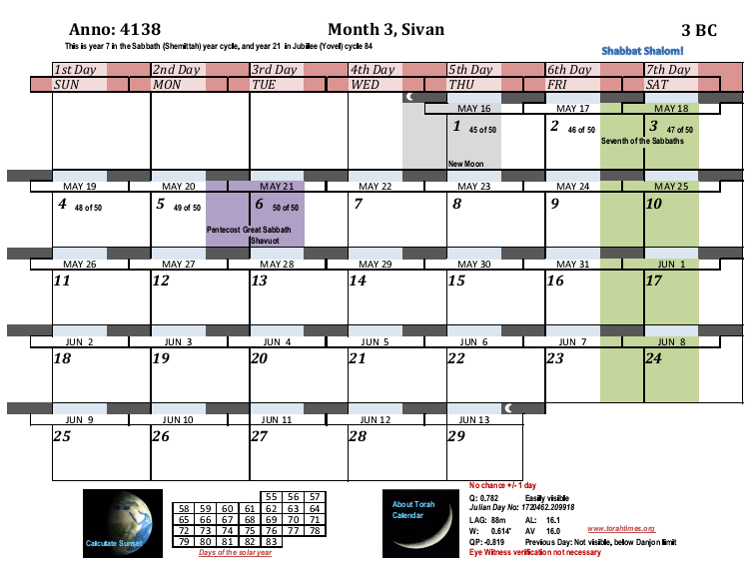
TRUE hypothesis conception date for John the Baptist
4137
1
Now we count off 6 months to reach the annunciation to Miriam. We see here that technically each month begins on the 3rd of the month.

Slide 31
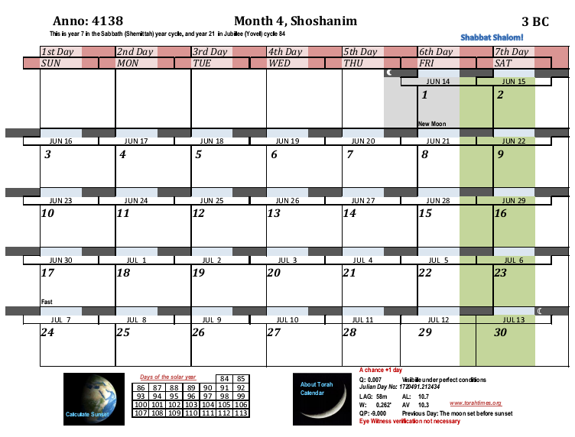
4137
2

Slide 32
4137
3

Slide 33
4137
4

Slide 34
4137
5

Slide 35
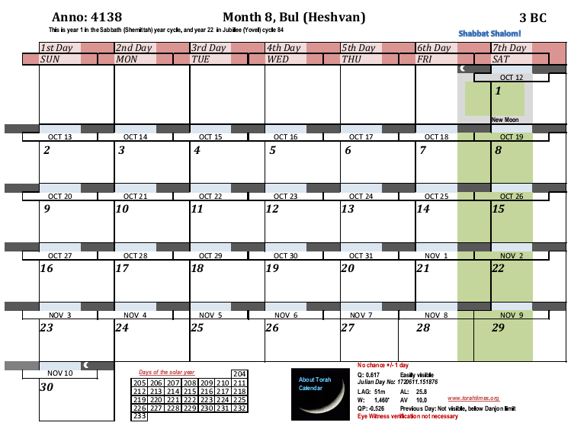
4137
The annunciation to Miriam was in the 6th month of Elizabeth. What is the reasonable amount of time here? What we need for the correct hypothesis (2 BC) is the maximum amount of time reasonable. So we will use the maximum reasonable time here. I am treating both theories exactly the same in this astronomical “thought” experiment.
6
Therefore, we will peg the TRUE hypothesis annunciation here on the new moon day.

Slide 36
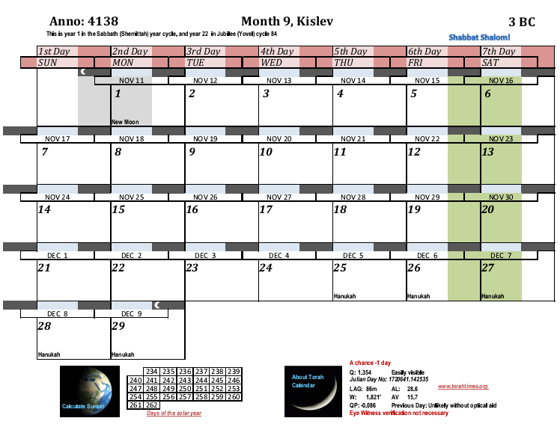
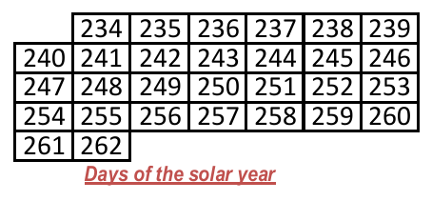
Annunciation Date
We say that Miryam had just begun the third week of her cycle at the annunciation, i.e. had just missed the time of fertility. That is she was on day 16 or so of the 28 day cycle. This means that conception comes in three weeks, on day 14 of the next cycle.
Now we have the TRUE conception date for Yeshua, the 25th day of the 9th month.
Note: the term TRUE here applies to the 2 BC hypothesis vs. the 3 BC Null hypothesis. I am not committing to an actual conception date here. It can vary a bit within reason.
4137
Start of new cycle
The 7th month of Elizabeth begins on the 3rd here.

Slide 37
We next look to see what day of the year the conception was on: 258.
The time from conception to birth averages 266 days. Often people will say 10 lunar months or 9 Roman months. The 10 month figure uses inclusive counting, and the both figures are from the date of the last cycle. Sometimes it is stated as 280 days. When the conception date is known however, the number of days is 266. This is a well researched and established figure. The difference between the conception date and the start of the last cycle is 14 days, i.e. 280 – 14 = 266. The reason for this is that women usually know when their cycle ends better than when they conceived.
Therefore, by adding 266 days to the day of the year (258) and then subtracting the solar year, we find the year target date for the birth in the next year. (This calculation is independent of this calendar system I am using. We are just going forward 266 days.)
266 + 258 – 365 = 159. The TRUE hypothesis birth is expected on day 159 of the year (counting from the spring equinox). Let us now fast forward to the month containing this date.
4137

Slide 38
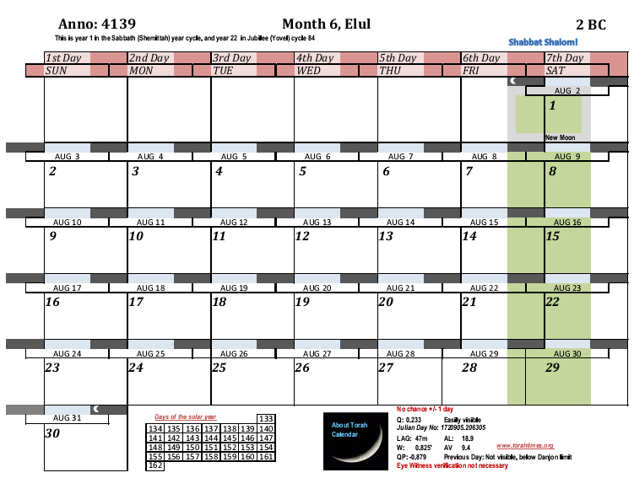
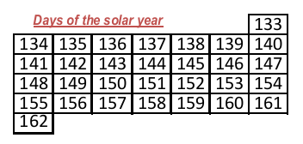
Here we are, at day 159 of the next year.
4138
We see that Yeshua was born just 3 days past the due date.
1
2
3

Slide 39
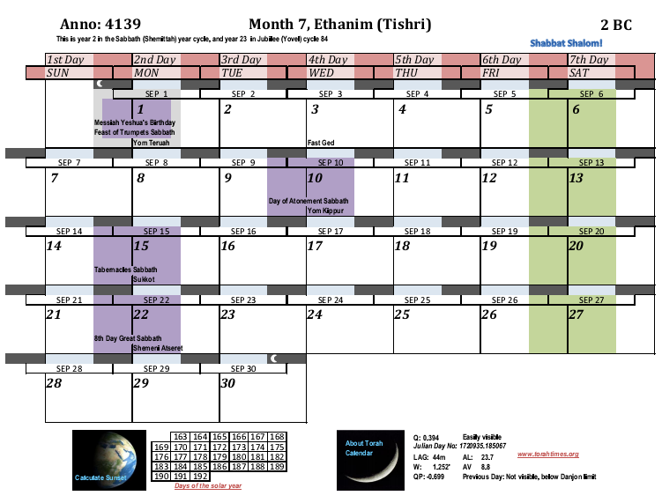
August 31st, 3 days past the due date.
4138
There is a messianic urban legend that says that Messiah was born on the feast of Tabernacles. The only “proof text” offered for this view is John 1:14, “And the Word became flesh and tabernacled among us.” There are serious objections to this interpretation:
The Word became flesh at His conception, not when he was born. In John’s symbolism the tabernacle (tent) refers to the human body, thus to say he only put on the tabernacle at the feast of tabernacles is to deny that life begins at conception.
John meant that Messiah tabernacled among us His whole life, not just at some specific feast date. Tabernacles (tents) are referred to in other biblical passages obviously having no connection the specific date of Tishri 15.
Paul uses the word tabernacle to refer to the human body, and he speaks of putting off the tabernacle of this body at death. If John 1:14 is supposed to mean Tishri 15, then do we suppose that Paul means everyone who dies dies after the sukkah’s are taken down from the feast of tabernacles?
Even more seriously, the urban legend contradicts Rev. 12:1-2 which says that Miryam was in hard labor, crying out, right when the sign happened. Are we thus to suppose she was in hard labor for two weeks?
Finally, the Tishri 15 assumption will make Yeshua 18 days over due in this year, and 45 days (@ 50 weeks) over due in 3 BC.

